Slide 1


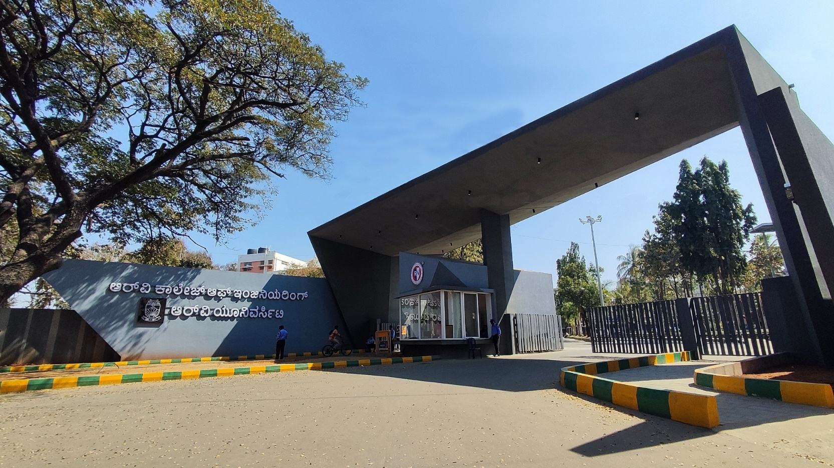
Smart Sort :Edge-AI Powered Rapid Grading System for Second-Life
Li-ion Cells
Renewable Energy- 20

Slide 2
EL PHASE-I
PRESENTATION OUTLINE
Introduction
Objectives & Problem Statement
Tools and techniques
Methodology flowchart
Battery grade qualifier
Sorting mechanism
Literature Review
Conclusion
References

Slide 3
INTRODUCTION
Overview: A rapid, low-cost instrumentation system designed to classify retired Lithium-ion batteries (18650) for reuse in renewable energy storage.
Importance: The transition to EVs is creating a "tsunami of e-waste." Recovering these batteries is essential to lower the cost of solar energy storage. Large industries mostly focusing on battery modules than loose cells.
Justification: Current grading methods are either too slow (Capacity Testing: 4+ hours) or too expensive. There is no viable tool for grading loose cells at scale for the circular economy.

Slide 4
OBJECTIVE &
PROBLEM STATEMENT
Problem Statement: The lack of rapid, scalable infrastructure to grade "loose" retired lithium-ion cells prevents their reuse, forcing viable batteries into premature recycling or landfills.
Main Objective: To design and develop a portable diagnostic system capable of grading Lithium-ion cells in under 60 seconds.

Slide 5
TOOLS & TECHNIQUIES USED
1. Hardware Architecture Components
Microcontroller Core (Arduino Uno): It generates a precise 1-second pulse signal via digital pins, handles I2C bus communications, and sequences data acquisition timings.
ADS1115 (ADC) : A 16-bit Sigma-Delta Analog-to-Digital Converter connected over the I2C bus. It provides a resolution voltage and current readings to the MCU
LM358 Operational Amplifier + Power MOSFET): An LM358 Op-Amp acts as an analog error amplifier in a negative feedback loop configuration. An N-Channel Power MOSFET (e.g., IRF540N) functions as a voltage-controlled variable resistor.
Power Shunt (1 Ohm Shunt) : A high-wattage power resistor that sits between the MOSFET Source and ground, serving as the physical feedback component for the operational amplifier.

Slide 6
TOOLS & TECHNIQUIES USED
2. Software & Machine Learning Model Architecture
LTspice : Used to execute the electrochemical modeling of lithium-ion cell degradation phenotypes (such as variable internal resistance, double-layer capacitance, and diffusion polarization parameters).
Arduino IDE: Utilized for writing the C++ hardware code, configuring I2C data rates, and operating the real-time serial transmission stream at 115200 Baud.
Python : The primary host software layer responsible for parsing incoming serial data vectors, transforming raw data streams, executing mathematical calculations, and running the machine learning runtime framework.
Random Forest Classifier: Random Forest is an ensemble learning method that constructs multiple decision trees during training. It is mathematically optimized for usage in edge devices, providing high generalization capabilities, immunity to overfitting, and an inherently fast computation timeline. Thus, the model can provide "Multi-Class Determinations" Classifies cells securely into discrete categories: Grade A (Healthy), Grade B (Moderate), or Grade C (Degraded). Confidence Score Evaluation: Passes the final decision voting matrices through a normalization layer to supply an interactive probability/confidence metric (e.g., Grade A: 94.5% certainty). This structure perfectly preserves an advanced, AI-driven evaluation ecosystem while executing on highly optimal, lightweight processing loops.

Slide 7
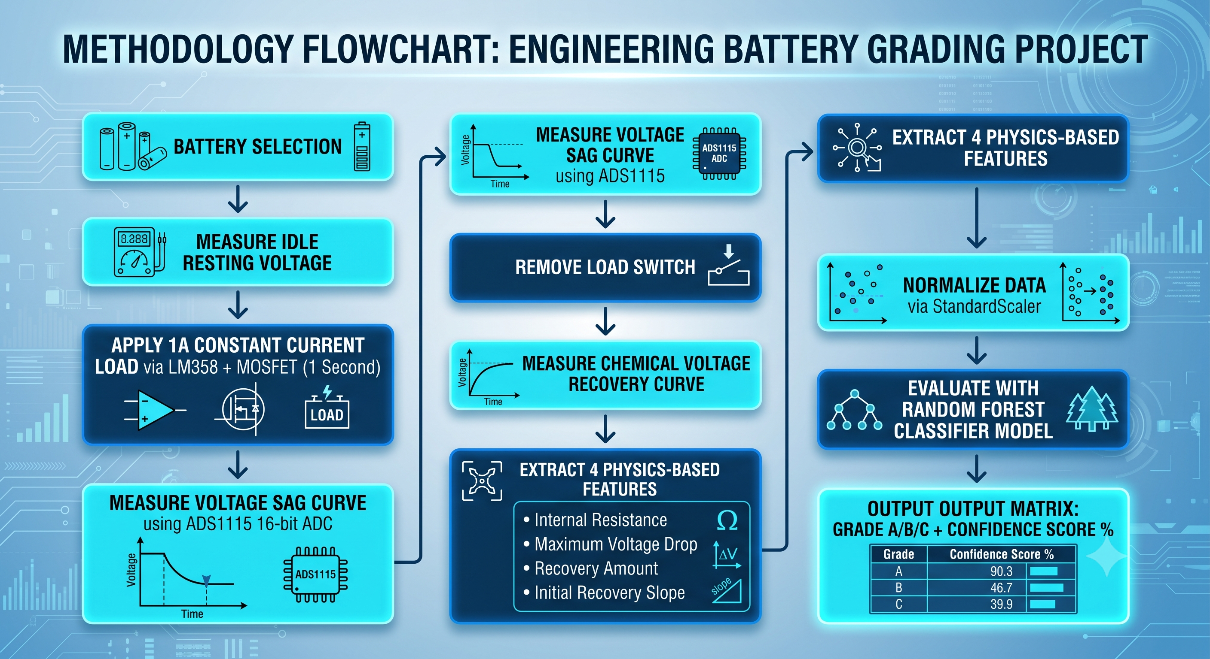
METHODOLOGY FLOWCHART

Slide 8
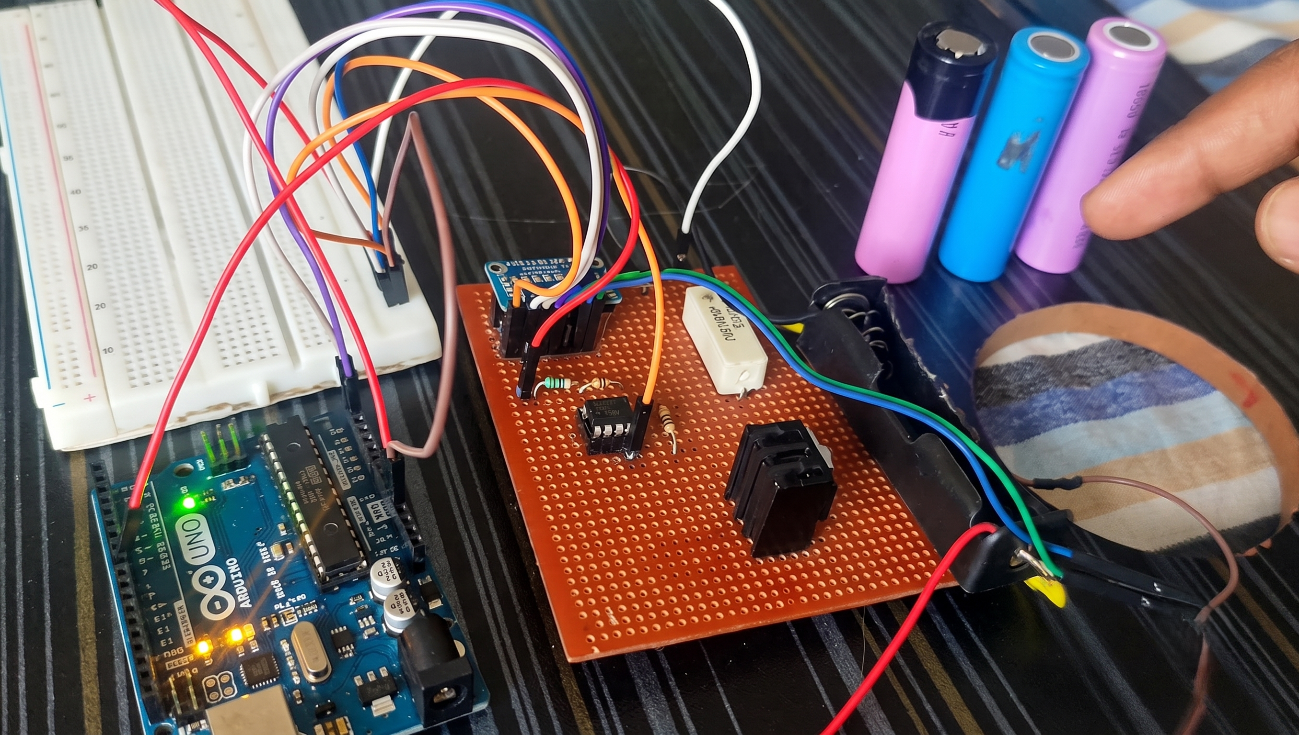
BATTERY GRADE QUALIFIER
Battery voltage and current are measured during the pulse test to assess battery health.
Key features such as voltage drop, voltage recovery, and internal resistance are extracted from the data.
A Random Forest machine learning model analyzes these features to determine the battery condition.
The battery is classified into three categories:
Grade A: Healthy battery suitable for direct reuse.
Grade B: Moderately aged battery suitable for secondary applications.
Grade C: Degraded battery recommended for recycling or safe disposal.
The classification result is sent to the ESP32, which automatically sorts the battery into the appropriate bin.

Slide 9
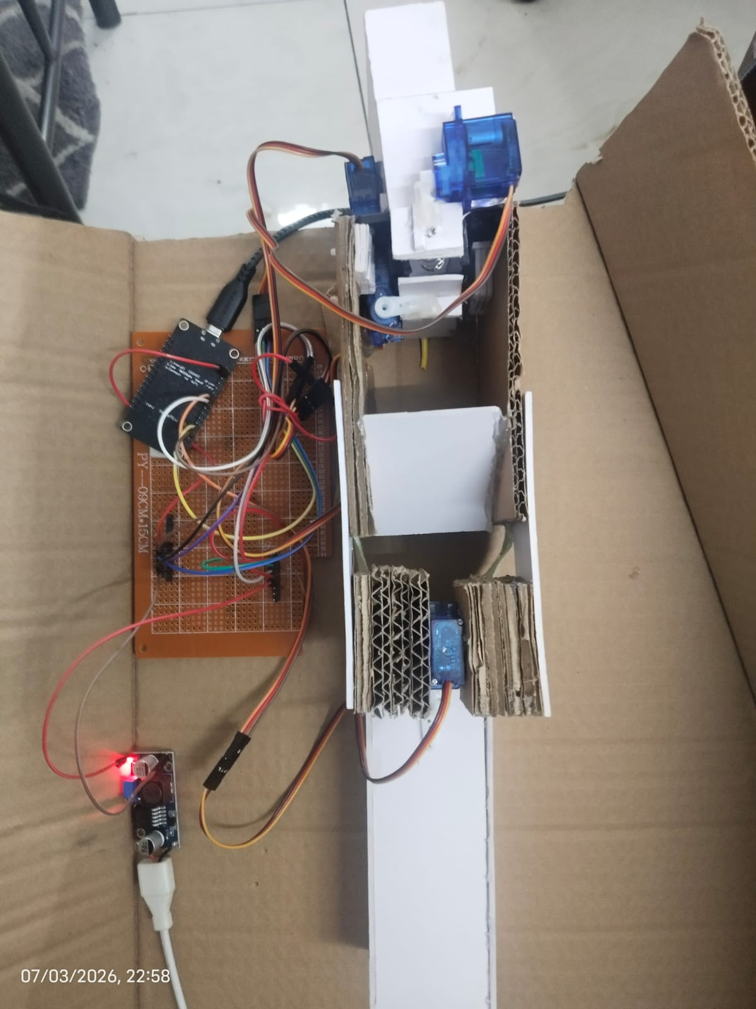
SORTING MECHANISM
To maximize efficiency, an automated physical sorting mechanism was integrated into the system, reducing processing time and enabling full automation. The current prototype serves as a functional demonstration model to prove this sorting concept, leaving room for further engineering and customization based on the end-user's specific requirements. The entire sorting operation is controlled by an ESP32 MCU, which precisely coordinates the timing commands sent to the respective servo motors for timely engagement and release. To ensure electrical safety and eliminate the risk of component burnouts, a dedicated boost converter was integrated into the prototype to safely supply stable power to all four servo motors simultaneously. While the proof-of-concept model is constructed from lightweight foam and cardboard sheets for rapid prototyping, the functional sorting mechanism located at the base dynamically adjusts its position based on control signals. These directives are handled by the ESP32, which seamlessly receives real-time classification results from the main evaluation unit over a UART communication protocol.

Slide 10
LITERATURE REVIEW
RESEARCH PAPER | AUTHORS AND YEAR OF PUBLISHING | CONTRIBUTIONS IN THE PAPER
A co-estimation framework for state of charge and parameters of lithium-ion battery with robustness to aging and usage conditions. | Natella, D., Onori, S., & Vasca, F. (2022) | Proposed a robust co-estimation framework (SOC + battery parameters) using recursive least-squares + observer techniques. This is useful because aging affects model parameters; this method shows how you can track parameters over battery life, which can tie into SOH estimation.
Co-Estimation of State of Charge and State of Health for Lithium-Ion Batteries Using an Enhanced Electrochemical Model. | Gao, Y., Liu, K., Zhu, C., Zhang, X., & Zhang, D. (2022) | Used an electrochemical equivalent-circuit model + estimation technique to co-estimate SOC and SOH. Helps in understanding how model-based SOH estimation is done in real world.

Slide 11
LITERATURE REVIEW
RESEARCH PAPER | AUTHORS AND YEAR OF PUBLISHING | CONTRIBUTIONS IN THE PAPER
Lithium Battery Health and Capacity : Estimation Techniques Using Embedded Electronics | Derek Heeger, Mike Partridge, Von Trullinger, Dan Wesolowski (2017) | Shows that battery SOH can be estimated using low-cost embedded electronics, without expensive lab tools. It proves that pulse/voltage-response signals and resistance changes contain reliable health information.
Practical Broadband Measurement of Battery EIS | Alessio De Angelis, Emanuele Buchicchio, Francesco Santoni, Antonio, Paolo Carbone (2021) | presents a low-complexity, flexible system for battery electrochemical impedance spectroscopy (EIS). It introduces broadband multisine excitation to achieve faster measurements compared to the conventional stepped-sine method.

Slide 12
CONCLUSION
Successful Automation Layer: We successfully designed and validated an automated sorting prototype controlled by an ESP32 microcontroller, drastically reducing cell handling time while paving the way for complete high-throughput screening.
Physics-Informed ML Accuracy: By transitioning from raw data curves to four distinct physics-based features, the Random Forest model achieved highly efficient and interpretable battery grading without computational bloat.
Robust Hardware Infrastructure: Integrating the ADS1115 16-bit ADC alongside an active LM358 constant-current load guaranteed millivolt-level precision and steady 1A pulse testing, making our data tracking exceptionally reliable.
Viable Second-Life Application: This proof-of-concept prototype offers a cost-effective, rapid, and scalable screening pipeline perfect for sorting salvaged lithium-ion cells for sustainable second-life battery applications.

Slide 13
REFERENCES
TITLE | AUTHORS | YEAR OF PUBLICATION
A co-estimation framework for state of charge and parameters of lithium-ion battery with robustness to aging and usage conditions. | Natella, D., Onori, S., & Vasca, F. | 2022
Co-Estimation of State of Charge and State of Health for Lithium-Ion Batteries Using an Enhanced Electrochemical Model. | Gao, Y., Liu, K., Zhu, C., Zhang, X., & Zhang, D. | 2022
Lithium Battery Health and Capacity : Estimation Techniques Using Embedded Electronics | Derek Heeger, Mike Partridge, Von Trullinger, Dan Wesolowski | 2017
Practical Broadband Measurement of Battery EIS | Alessio De Angelis, Emanuele Buchicchio, Francesco Santoni, Antonio, Paolo Carbone | 2021

Slide 14
REFERENCES
Natella, D., Onori, S., & Vasca, F. (2022). A co-estimation framework for state of charge and parameters of lithium-ion battery with robustness to aging and usage conditions. IEEE Transactions on Industrial Electronics, 69(12), 12489–12499. https://ieeexplore.ieee.org/document/9856595/authors#authors
Lai, X., Yuan, M., Tang, X., Yao, Y., Weng, J., Gao, F., Ma, W., & Zheng, Y. (2021). Co-estimation of state of charge and state of health for lithium-ion batteries using an enhanced electrochemical model. IEEE Transactions on Power Electronics, 36(6), 6302–6313. https://ieeexplore.ieee.org/document/9384220
Heeger, D., Partridge, M., Trullinger, V., & Wesolowski, D. (2017). Lithium battery health and capacity: Estimation techniques using embedded electronics (SAND2017-10722). Sandia National Laboratories. https://www.osti.gov/servlets/purl/1596204
De Angelis, A., Carbone, P., Moschitta, A., Crescentini, M., Ramilli, R., & Traverso, P. A. (2021). Practical broadband measurement of battery EIS. IEEE Transactions on Instrumentation and Measurement, 70, 1–10. https://ieeexplore.ieee.org/document/9502889
Sun, Y., Smith, K., & Mohan, A. (2025). Evaluating the use of rapid DC pulses for diagnosing lithium-ion batteries (NREL/TP-5400-XXXX). National Renewable Energy Laboratory. https://docs.nrel.gov/docs/fy25osti/92155.pdf
Lam, D. H. C., & Lim, Y. S. (2022). State of charge, state of health, and degradation estimation for second-life batteries for maximum demand reductions. IEEE Access, 10, 133771–133782. https://ieeexplore.ieee.org/document/9988844

Slide 15


